Slide 1
San Francisco Building Permits 2013-2017
Presented by: Aaya Ali
DAB-14

Slide 2
Audience
Government officials & city planners
Construction companies
Problem Statement
Getting construction permits in San Francisco is often slow, unpredictable, and unclear. This can delay projects and cost companies a lot of money. For example, the 33 Tehama Street building faced long permit delays after a water leak, leaving the building empty, work stopped, and millions lost.

Slide 3
Main Goal:
Identify the Factors That Affect The Approval of The Permits, to support better decision maker to improve permits system.
Objectives:
To understand the Distribution and Trends of Building Permits in San Francisco to identify patterns that may affect project approval and costs.
To compare How Long Different Types of Permits Take to be Approved, highlighting which permit types face longer delays and may need process improvements.
To Identify the Most Frequently Occurring Number of Floors in Buildings applying for permits, helping to understand typical building sizes in San Francisco’s construction activity.
To analyze How The Number of Permit Applications Has Changed Across Years, helping identify growth patterns or declines in construction activity.

Slide 4
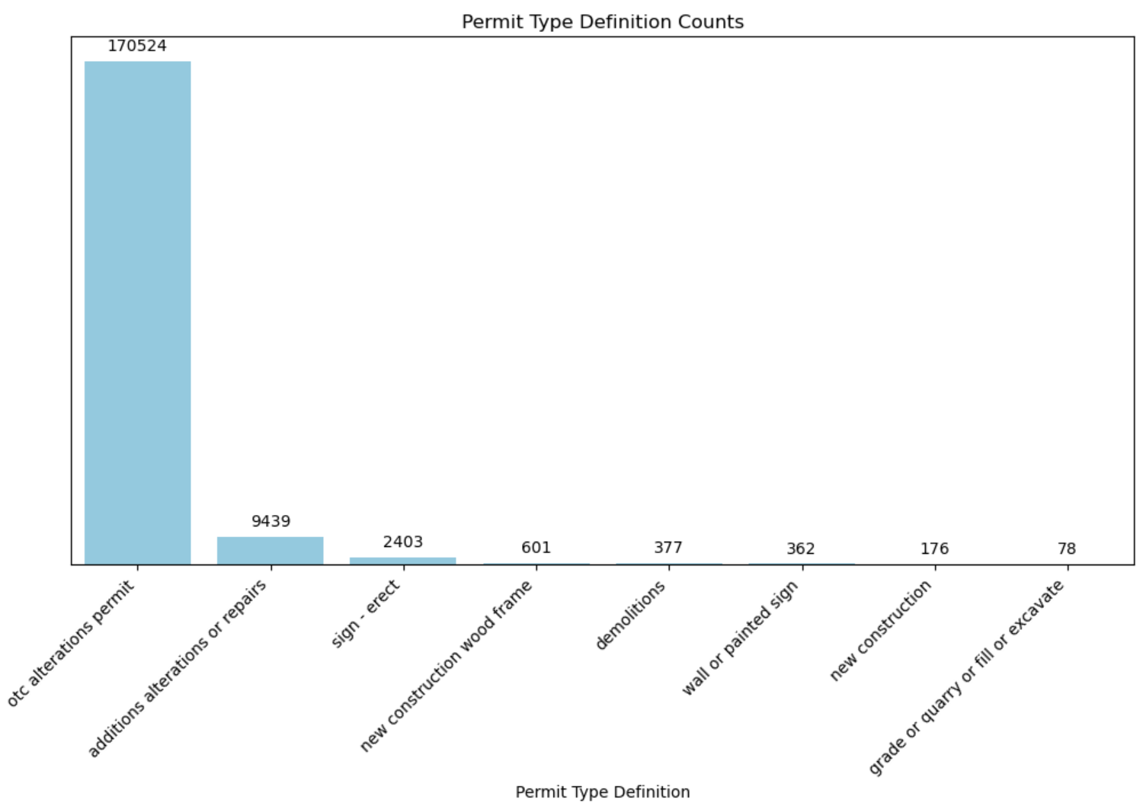
Most Permit Types in San Francisco
OTC: Over The Counter Permits

Slide 5
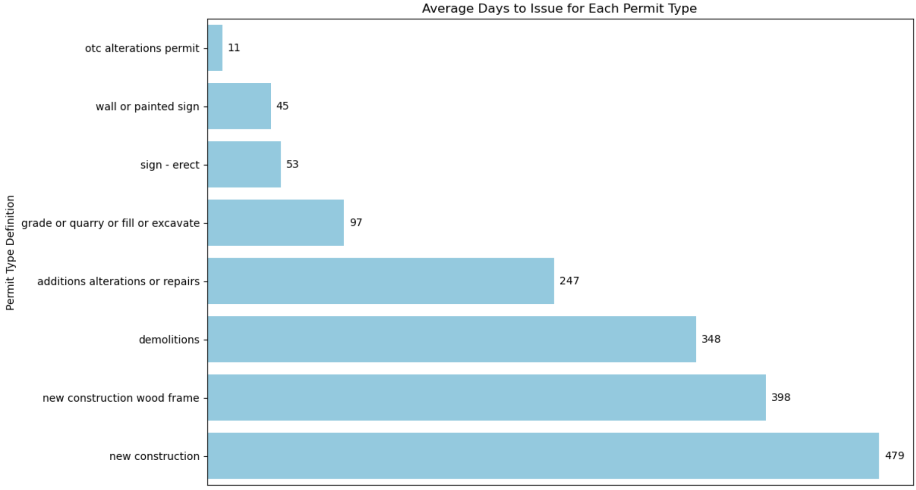
Average Approval Time by Permit Type in San Francisco

Slide 6
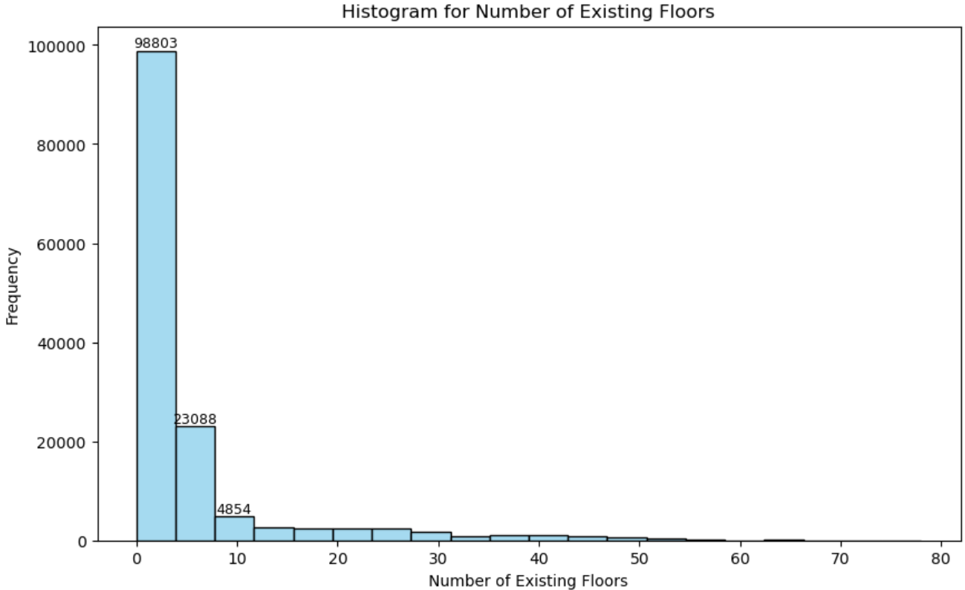
Most Common Building Floors in Permit Applications

Slide 7
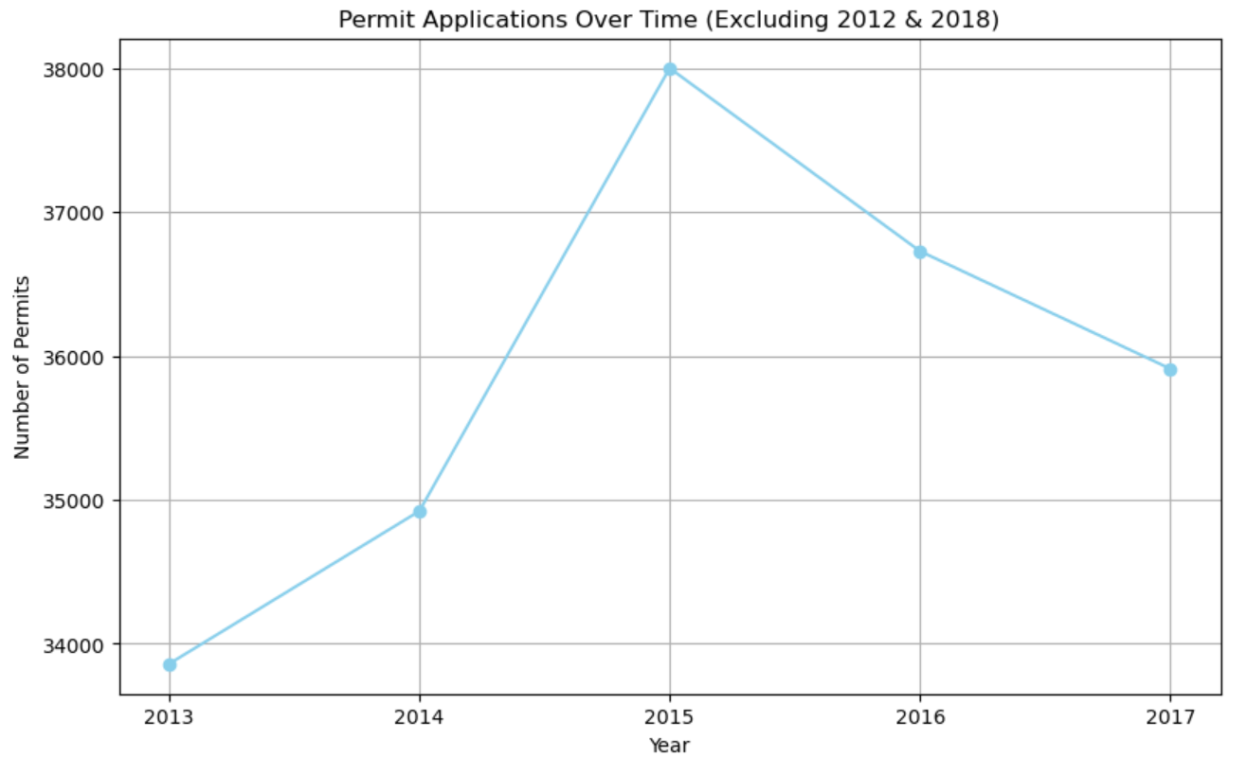
Trends in Permit Applications Over Time

Slide 8
Other Objectives:
To identify the neighborhoods with the highest number of permit applications, helping reveal where construction activity is most concentrated in San Francisco.
To analyze the distribution of permit types within the top neighborhood by permit volume, providing insight into the specific construction activities driving demand in that area.
To compare the median estimated costs across different permit types, highlighting which types of construction projects are the most financially demanding and which are relatively lower cost. This helps identify cost drivers in the permit approval system.
Identify how each permit type changed over time.

Slide 9
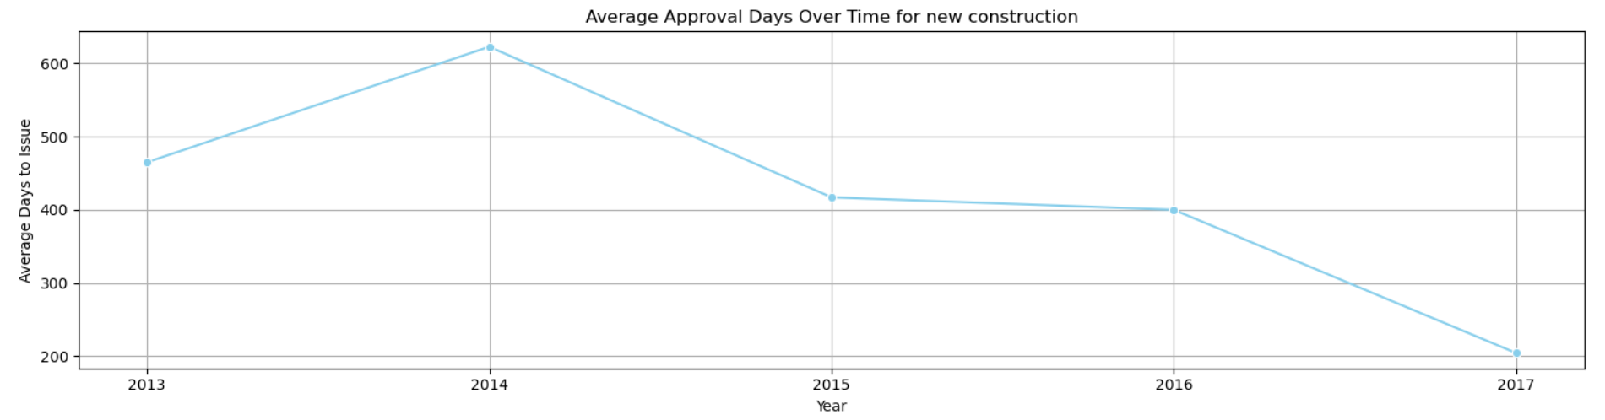
Slowest Permit Type
New Construction Permit Faced a High Day Delays in 2014

Slide 10
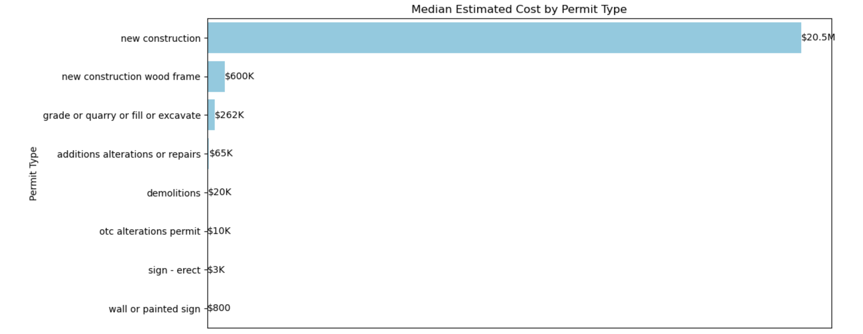
Costs Across Different Permit Types

Slide 11
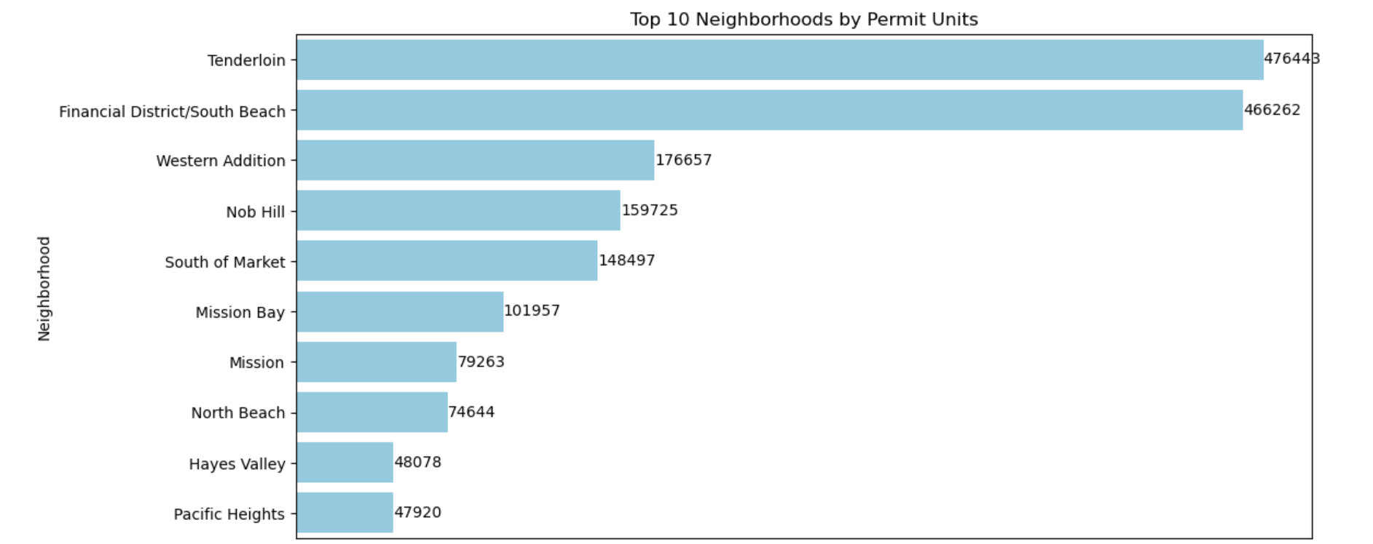
Neighborhoods & Units
Units can be houses or apartments

Slide 12
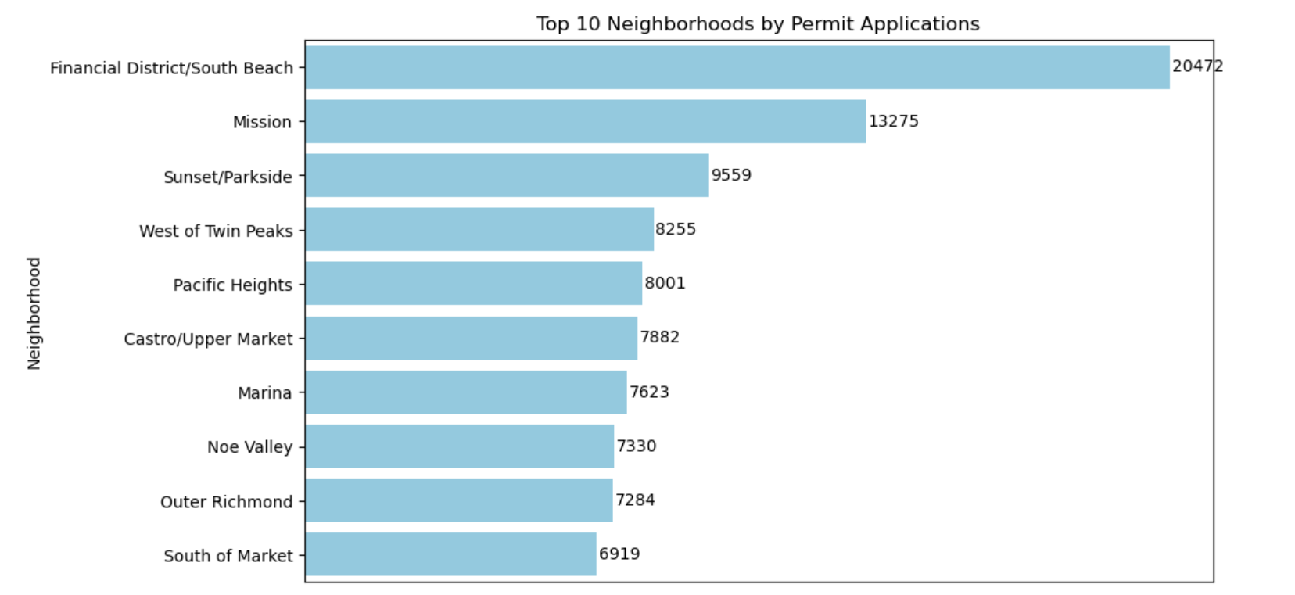
Neighborhoods With High Permits Number

Slide 13
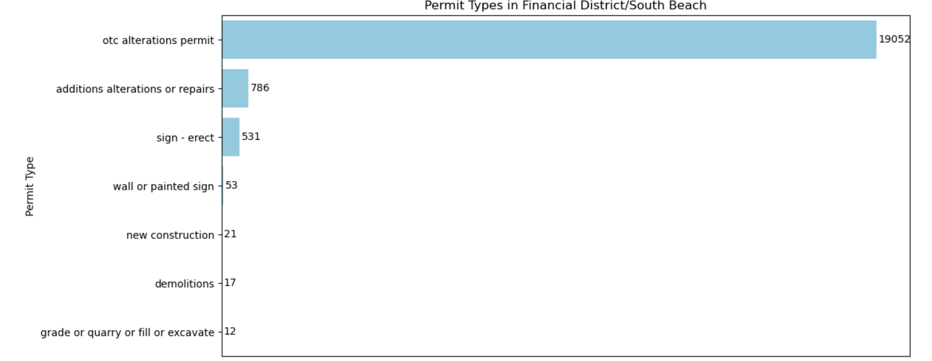
Financial District - OTC Alteration Permit

Slide 14
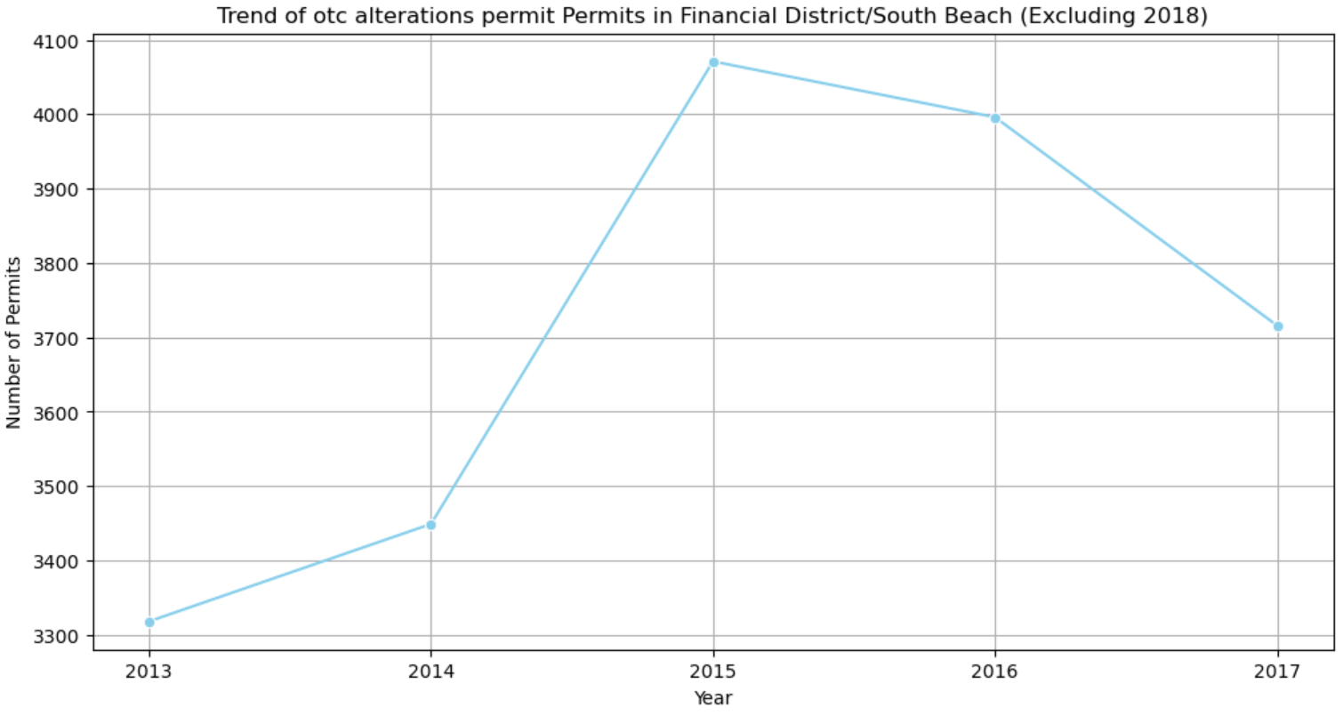
The highest number of permits was in 2015 more than 4000

Slide 15
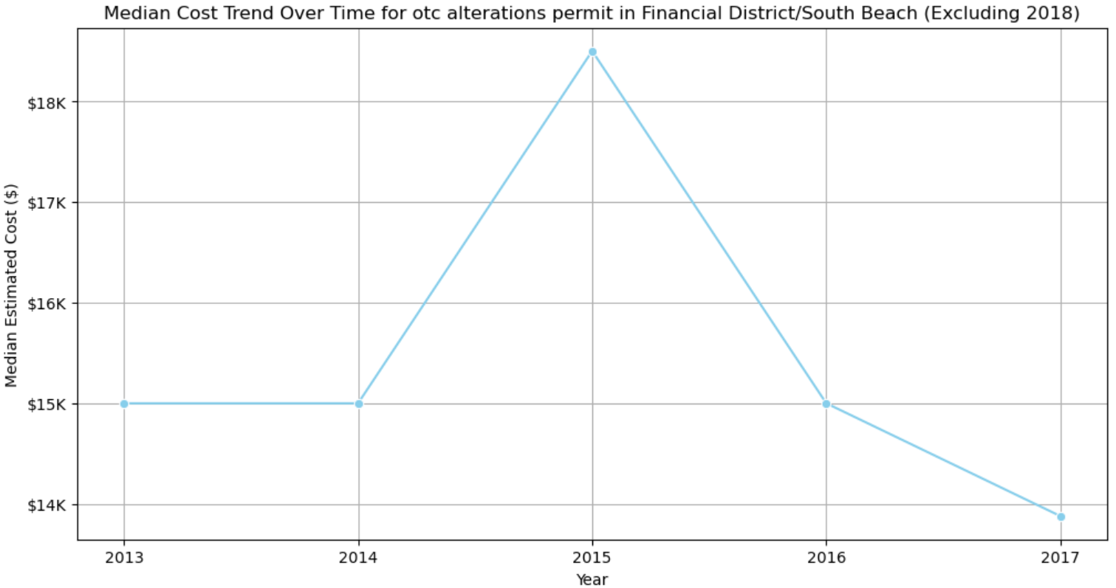
The highest Cost was more than $18K in 2015

Slide 16
Thank You

